Slide 1
Design and Analysis of Algorithms Non-comparison sort (sorting in linear time)
Some Slides from Haidong Xue

Slide 2
Sorting in linear time
Can we sort an array in linear time?
Yes, but not for free
E.g. sort cards with 13 slots
What if there are more than one elements in the same slot?

Slide 3
Counting Sort
Input: array A[1, … , n]; k (elements in A have values from 1 to k)
Output: sorted array A
Algorithm:
Create a counter array C[1, …, k]
Create an auxiliary array B[1, …, n]
Scan A once, record element frequency in C
Calculate prefix sum in C
Scan A in the reverse order, copy each element to B at the correct position according to C.
Copy B to A

Slide 4
Counting Sort
1
2
3
4
5
6
7
8
A:
2
3
7
3
2
5
3
6
2
5
3
6
2
3
7
3
C:
1
2
3
4
5
6
7
0
2
3
0
1
1
1
0
2
3
5
5
8
4
6
7
1
5
7
Position indicator:
0
2
6
1
2
3
4
5
6
7
8
B:

Slide 5
Analysis of Counting Sort
Input: array A[1, … , n]; k (elements in A have values from 1 to k)
Output: sorted array A
Algorithm:
Create a counter array C[1, …, k]
Create an auxiliary array B[1, …, n]
Scan A once, record element frequency in C
Calculate prefix sum in C
Scan A in the reverse order, copy each element to B at the correct position according to C.
Copy B to A
Time
Space
O(k)
O(n)
O(n)
O(k)
O(n)
O(n)
O(n+k)=O(n) (if k=O(n))
O(n+k)=O(n) (if k=O(n))

Slide 6
Radix-Sort
Input: array A[1, … , n]; d (number of digit a element has)
Output: sorted array A
Algorithm:
for each digit{
use a stable sort to sort A on a digit
}
T(n)=O(d(n+k))

Slide 7
Radix-Sort
http://www.personal.kent.edu/~rmuhamma/Algorithms/MyAlgorithms/Sorting/radixSort.htm

Slide 8
Bucket-Sort
http://www.personal.kent.edu/~rmuhamma/Algorithms/MyAlgorithms/Sorting/bucketSort.htm

Slide 9
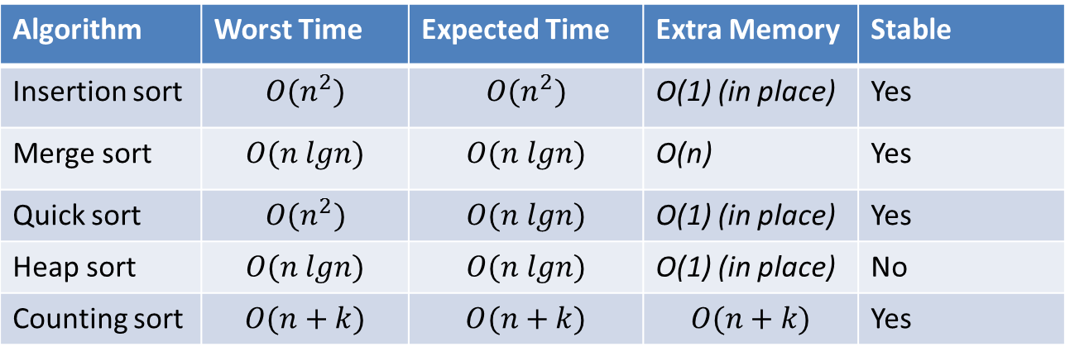
Summary
Algorithm | Worst Time | Expected Time | Extra Memory | Stable
Insertion sort | $$O(n^{2})$$ | $$O(n^{2})$$ | O(1) (in place) | Yes
Merge sort | $$O(n lgn)$$ | $$O(n lgn)$$ | O(n) | Yes
Quick sort | $O(n^{2})$ | $$O(n lgn)$$ | O(1) (in place) | Yes
Heap sort | $$O(n lgn)$$ | $$O(n lgn)$$ | O(1) (in place) | No
Counting sort | $$O(n+k)$$ | $$O(n+k)$$ | $$O(n+k)$$ | Yes
Design strategies:
Divide and conquer
Employ certain special data structure
Tradeoff between time and space

Slide 10
Knowledge tree
Algorithms
Analysis
Design
Algorithms for classic problems
Classic data structure
Sorting
Shortest path
Matrix multiplication
…
Asymptotic notations
Probabilistic analysis
Heap,
Hashing,
Binary Tree,
RBT,
….
Divide & Conquer
Greedy
Dynamic Programming
O(),
o(),
Θ(), Ω(),
ω()
Quicksort,
Heapsort,
Mergesort,
…
…
…
…
…
…
…
…
…
…
…
…
…
…
…
…
…
…
…
…

